Slide 1

Silver Oak University
Name of Group Members : Group Id :- 189
Darshit Malaviya (220403100610)
Prince Tejani (2204030101084)
Disha Dhameliya (2204030100248)
Jenis Bambhaniya (2204030100048)
Notes:
Our team consists of 4 members - Darshit, Prince, Disha, and Jenis
We've come together to work on this project as a collaborative group
Each of us brings unique skills and perspectives that will contribute to the success of this presentation
We're excited to share our work with you today and demonstrate what we've accomplished as a team

Slide 2

What is calories
Calories for humans is just like charging in mobile , if condition of mobile battery is in 1-100 range its normal just like humans if out BODY MASS INDEX falls in 18.5 to 25.5 range its normal weight

Slide 3
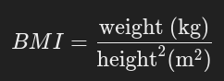
What is BMI ?
- BMI stands for Body Mass Index
- if we know our weight , height we can calculate through mathematical expression

Slide 4
If OUTPUT
- Comes <18.5
- Person is underweight
- Comes >18.5 and <24.5
- Person weight is normal
- Comes > 24.5
- Person is over weight

Slide 5
AI Diet Recommendation System: Overview
Introducing a revolutionary web app for personalized weight management. Leveraging React for a dynamic and user-friendly interface. AI-powered diet recommendations based on individual user weight and goals. Core Tech Stack: React, Machine Learning (specific model type), AI (specific algorithms).

Slide 6

Solution: AI-Powered Personalized Diet Recommendations
1
Our system analyzes user weight, height, age.
2
Utilizes machine learning algorithms trained on a dataset of diverse individuals and their dietary responses.
3
AI model considers key nutritional parameters (e.g., macronutrient ratios, calorie intake, micronutrient needs) for optimal health.

Slide 7
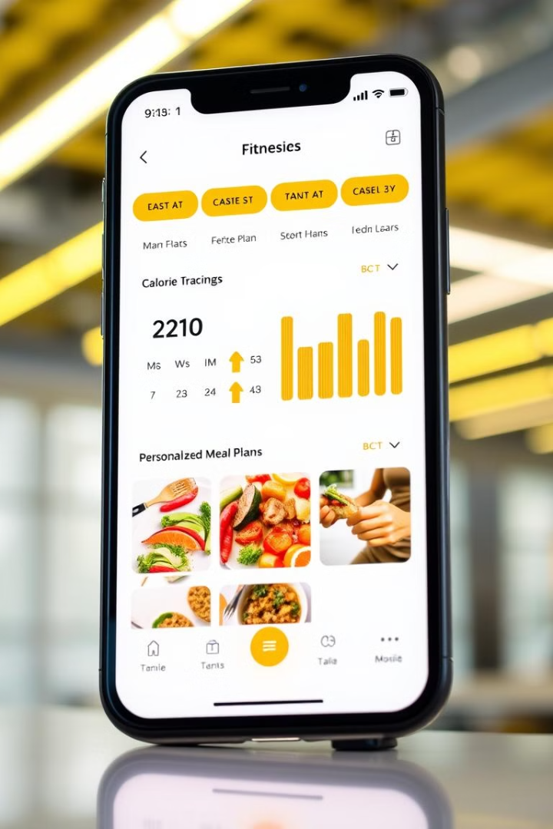
React Frontend: User-Friendly Interface
Intuitive user onboarding and profile creation process.
Interactive user experience.
Dynamic display of AI-generated diet recommendations, including meal plans and recipes.
Track record of user

Slide 8
Benefits: Personalized, Effective, and Sustainable
Achieved an average weight loss of in weeks among beta users.
1
2
Improved user adherence to diet plans compared to generic approaches (cite data).
Enhanced overall health and well-being through tailored nutrition guidance.
3
4
Sustainable weight management through continuous adaptation and feedback loops.
Reduction of risk of healths
5

Slide 9
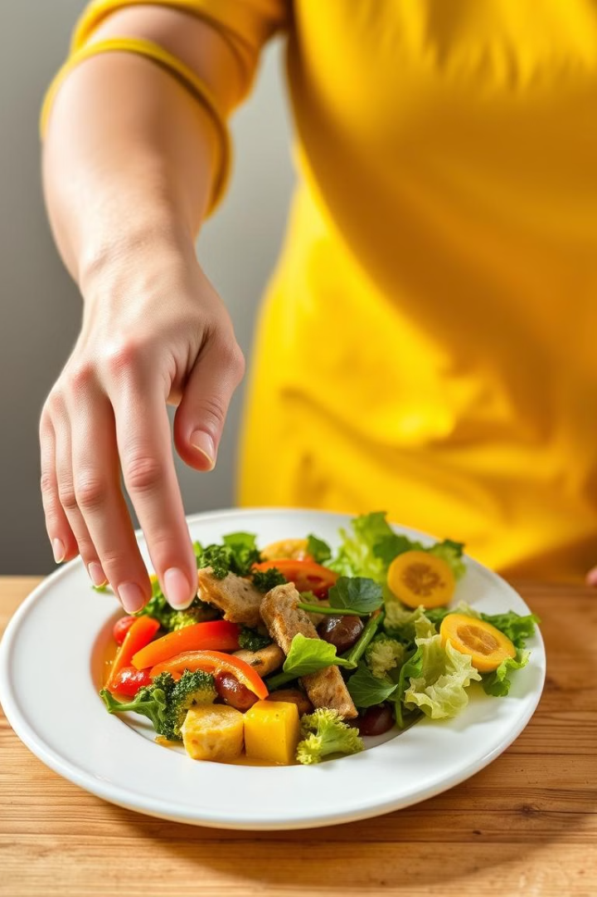
Conclusion: The Future of Personalized Weight Management
Our React-based AI diet recommendation system offers a unique and impactful solution. We are committed to empowering individuals to achieve their weight management goals through personalized nutrition. Invitation to join us in revolutionizing the way people approach healthy eating. Call to action: Visit our website, sign up for a free trial, and experience the power of AI-driven weight management.

